Slide 1
Information to Advocate for Maintaining the National Eye Institute (NEI)
This slide deck has talking points and data to promote vision and eye research, specifically aimed at convincing Congress to keep “eye” in NIH . The last slide has information on paths to advocacy.
Key points and consequences of the White House Office of Management and Budget dated April 10, 2025
These changes would dramatically cut vision research and the ability to develop cutting-edge vision therapies to treat visual impairments and blindness
This information is meant to be shared, edited, and expanded upon to create a grassroots effort to Promote Eye Research and Save the NEI.
To Save Sight and Save the NEI, contact Congress, see Contact Congress - NAEVR/AEVR
Key points | Consequences
Consolidate the number of NIH institutes from 27 to 8 | Eliminates the NEI and allocation of vision-specific funding
Reduce the NIH budget by 43% ($20 billion) | Cripples US jobs, economy, and discovery of new diagnoses and treatments
Cap the indirect rate at 15% | Impairs support for biomedical research
Internal Trump administration document reveals massive
Notes:
Information compiled by Machelle Pardue, mpardue@emory.edu and Andrew Feola Andrew.Feola@emory.edu

Slide 2

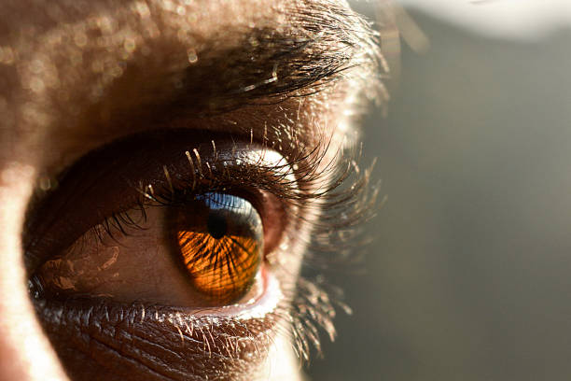
Most Americans would rather lose a limb
than lose eyesight
Vision health is important for quality of life
Save Sight, Save the NEI
Scott et al., JAMA Ophthalmol. 2016;134(10):1111-1118. doi:10.1001/jamaophthalmol.2016.2627
https://jamanetwork.com/journals/jamaophthalmology/fullarticle/2540516
Notes:
Scott et al., JAMA Ophthalmol. 2016;134(10):1111-1118. doi:10.1001/jamaophthalmol.2016.2627
https://jamanetwork.com/journals/jamaophthalmology/fullarticle/2540516

Slide 3
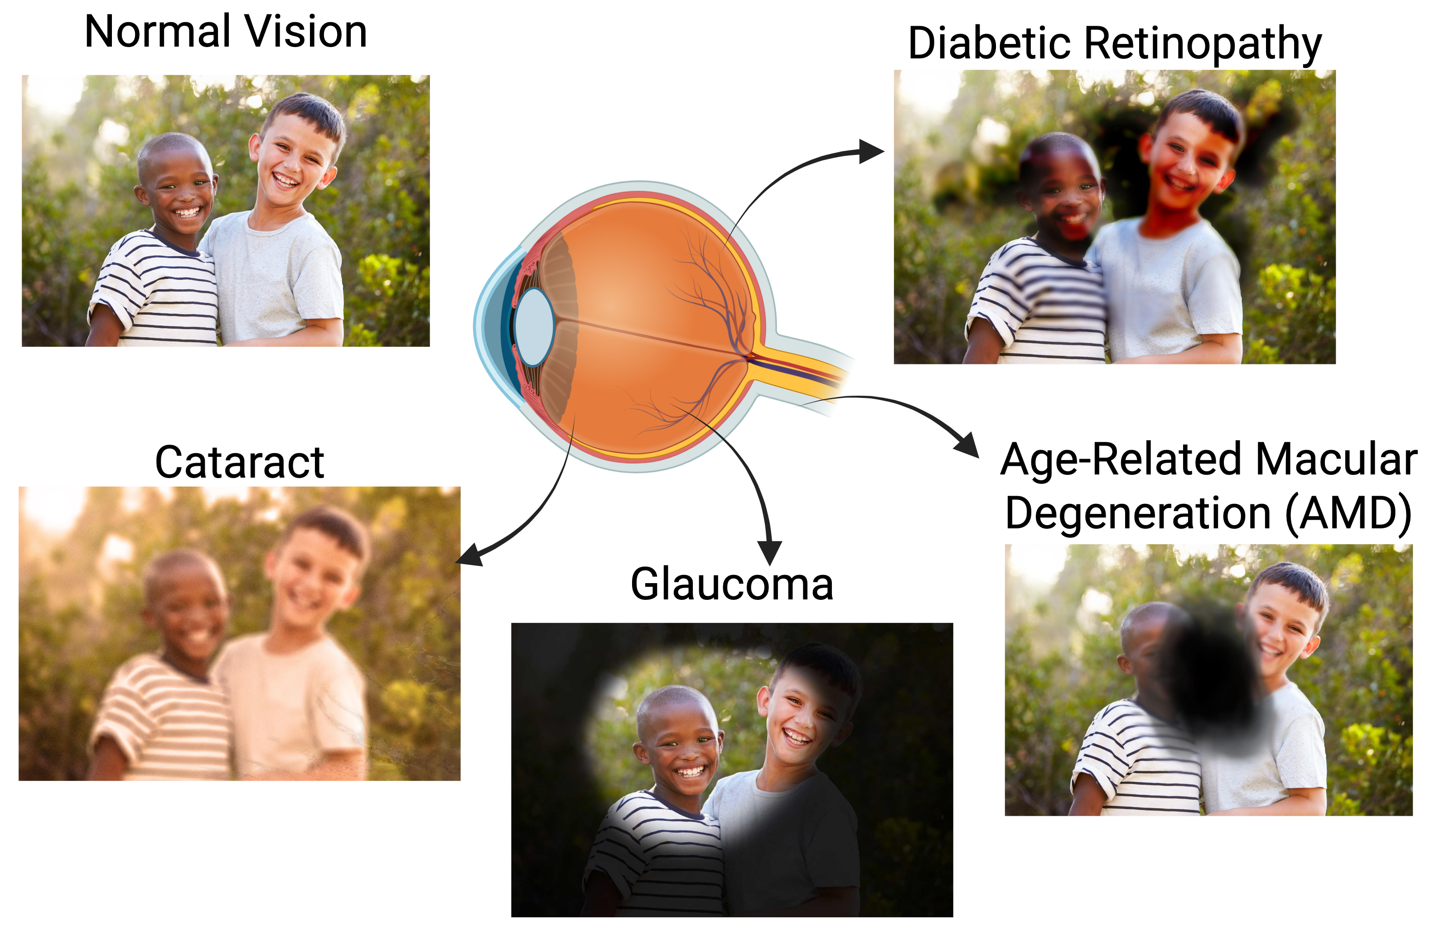
Developing cures and treatments for these causes of chronic visual impairment require years of rigorous research
Save Sight, Save the NEI
https://medialibrary.nei.nih.gov/

Slide 4
Visual loss has significant economic impact with
alarmingly low vision research investment
Economic burden: $199 billion in 2025
$865 per American
Federal vision research funding: $896.5 million since 2023
$2.65 per American
Preserving vision saves money
Save Sight, Save the NEI
www.eyeresearch.org

Slide 5
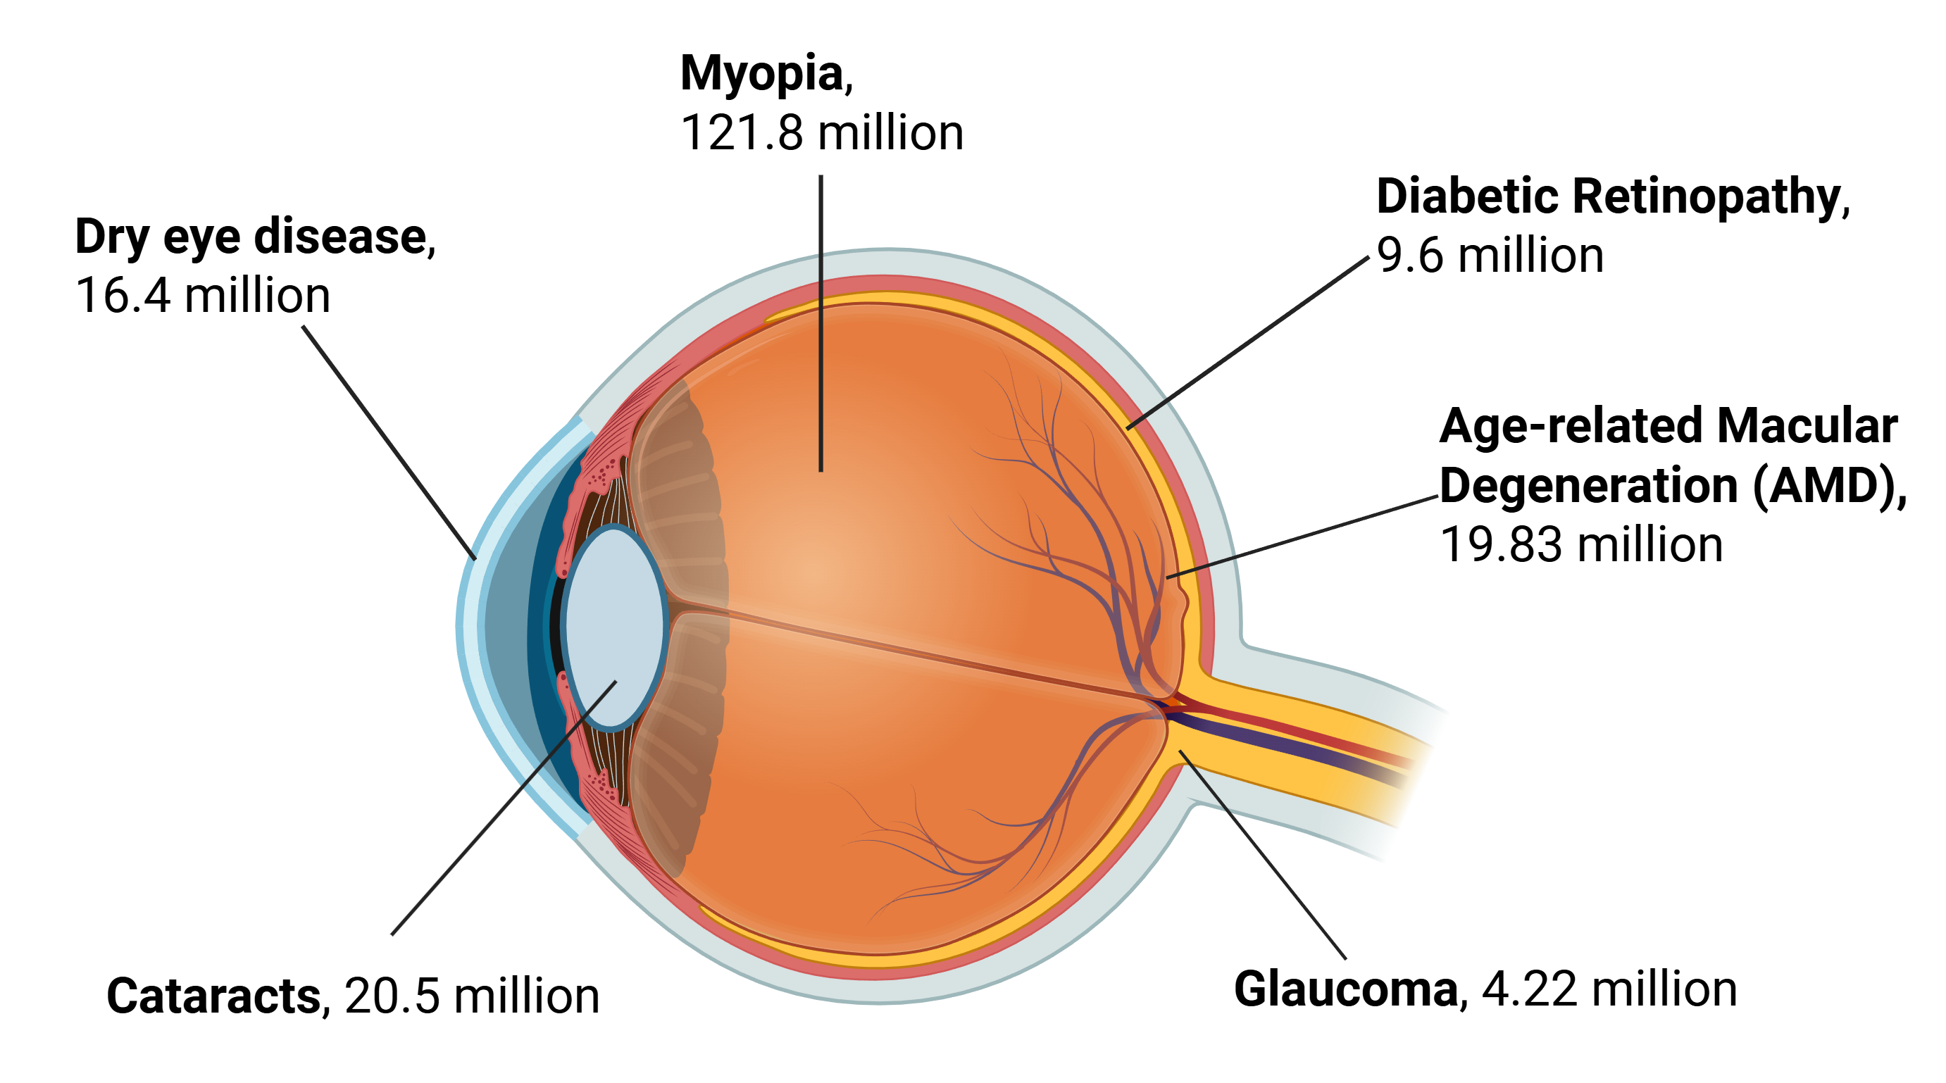
Research and discovery on all parts of the eye are needed to address visual impairments affecting 192.35 million Americans
Save Sight, Save the NEI
Rein et al. JAMA Ophthalmol. 2022. doi: 10.1001/jamaophthalmol.2022.4401; https://www.nvisioncenters.com/education/eye-disease-statistics/#cataracts; https://pubmed.ncbi.nlm.nih.gov/28705660/; https://www.cdc.gov/vision-health-data/prevalence-estimates/dr-prevalence.html; https://www.cdc.gov/vision-health-data/prevalence-estimates/prevalence-estimates-glaucoma.html; NASEM Myopia report: https://www.ncbi.nlm.nih.gov/sites/books/NBK607610/#:~:text=TABLE%203%2D4,8%2Dfold%20increase%20in%20prevalence
Notes:
Rein DB, Wittenborn JS, Burke-Conte Z, Gulia R, Robalik T, Ehrlich JR, Lundeen EA, Flaxman AD. Prevalence of Age-Related Macular Degeneration in the US in 2019. JAMA Ophthalmol. 2022 Dec 1;140(12):1202-1208. doi: 10.1001/jamaophthalmol.2022.4401. PMID: 36326752; PMCID: PMC9634594.
https://www.nvisioncenters.com/education/eye-disease-statistics/#cataracts
https://pubmed.ncbi.nlm.nih.gov/28705660/
https://www.cdc.gov/vision-health-data/prevalence-estimates/dr-prevalence.html
https://www.cdc.gov/vision-health-data/prevalence-estimates/prevalence-estimates-glaucoma.html
NASEM Myopia report; https://www.ncbi.nlm.nih.gov/sites/books/NBK607610/#:~:text=TABLE%203%2D4,8%2Dfold%20increase%20in%20prevalence.; 292.8 million (2004), 41.6% myopia = 121.8 mil

Slide 6




These diseases do not fit with the re-organization of NEI into the proposed “Institute of Neuroscience and Brain Research”
Save Sight, Save the NEI
Rein et al. JAMA Ophthalmol. 2022. doi: 10.1001/jamaophthalmol.2022.4401; https://www.nvisioncenters.com/education/eye-disease-statistics/#cataracts; https://pubmed.ncbi.nlm.nih.gov/28705660/; https://www.cdc.gov/vision-health-data/prevalence-estimates/dr-prevalence.html; https://www.cdc.gov/vision-health-data/prevalence-estimates/prevalence-estimates-glaucoma.html; NASEM Myopia report: https://www.ncbi.nlm.nih.gov/sites/books/NBK607610/#:~:text=TABLE%203%2D4,8%2Dfold%20increase%20in%20prevalence
Notes:
Rein DB, Wittenborn JS, Burke-Conte Z, Gulia R, Robalik T, Ehrlich JR, Lundeen EA, Flaxman AD. Prevalence of Age-Related Macular Degeneration in the US in 2019. JAMA Ophthalmol. 2022 Dec 1;140(12):1202-1208. doi: 10.1001/jamaophthalmol.2022.4401. PMID: 36326752; PMCID: PMC9634594.
https://www.nvisioncenters.com/education/eye-disease-statistics/#cataracts
https://pubmed.ncbi.nlm.nih.gov/28705660/
https://www.cdc.gov/vision-health-data/prevalence-estimates/dr-prevalence.html
https://www.cdc.gov/vision-health-data/prevalence-estimates/prevalence-estimates-glaucoma.html
NASEM Myopia report; https://www.ncbi.nlm.nih.gov/sites/books/NBK607610/#:~:text=TABLE%203%2D4,8%2Dfold%20increase%20in%20prevalence.; 292.8 million (2004), 41.6% myopia = 121.8 mil

Slide 7
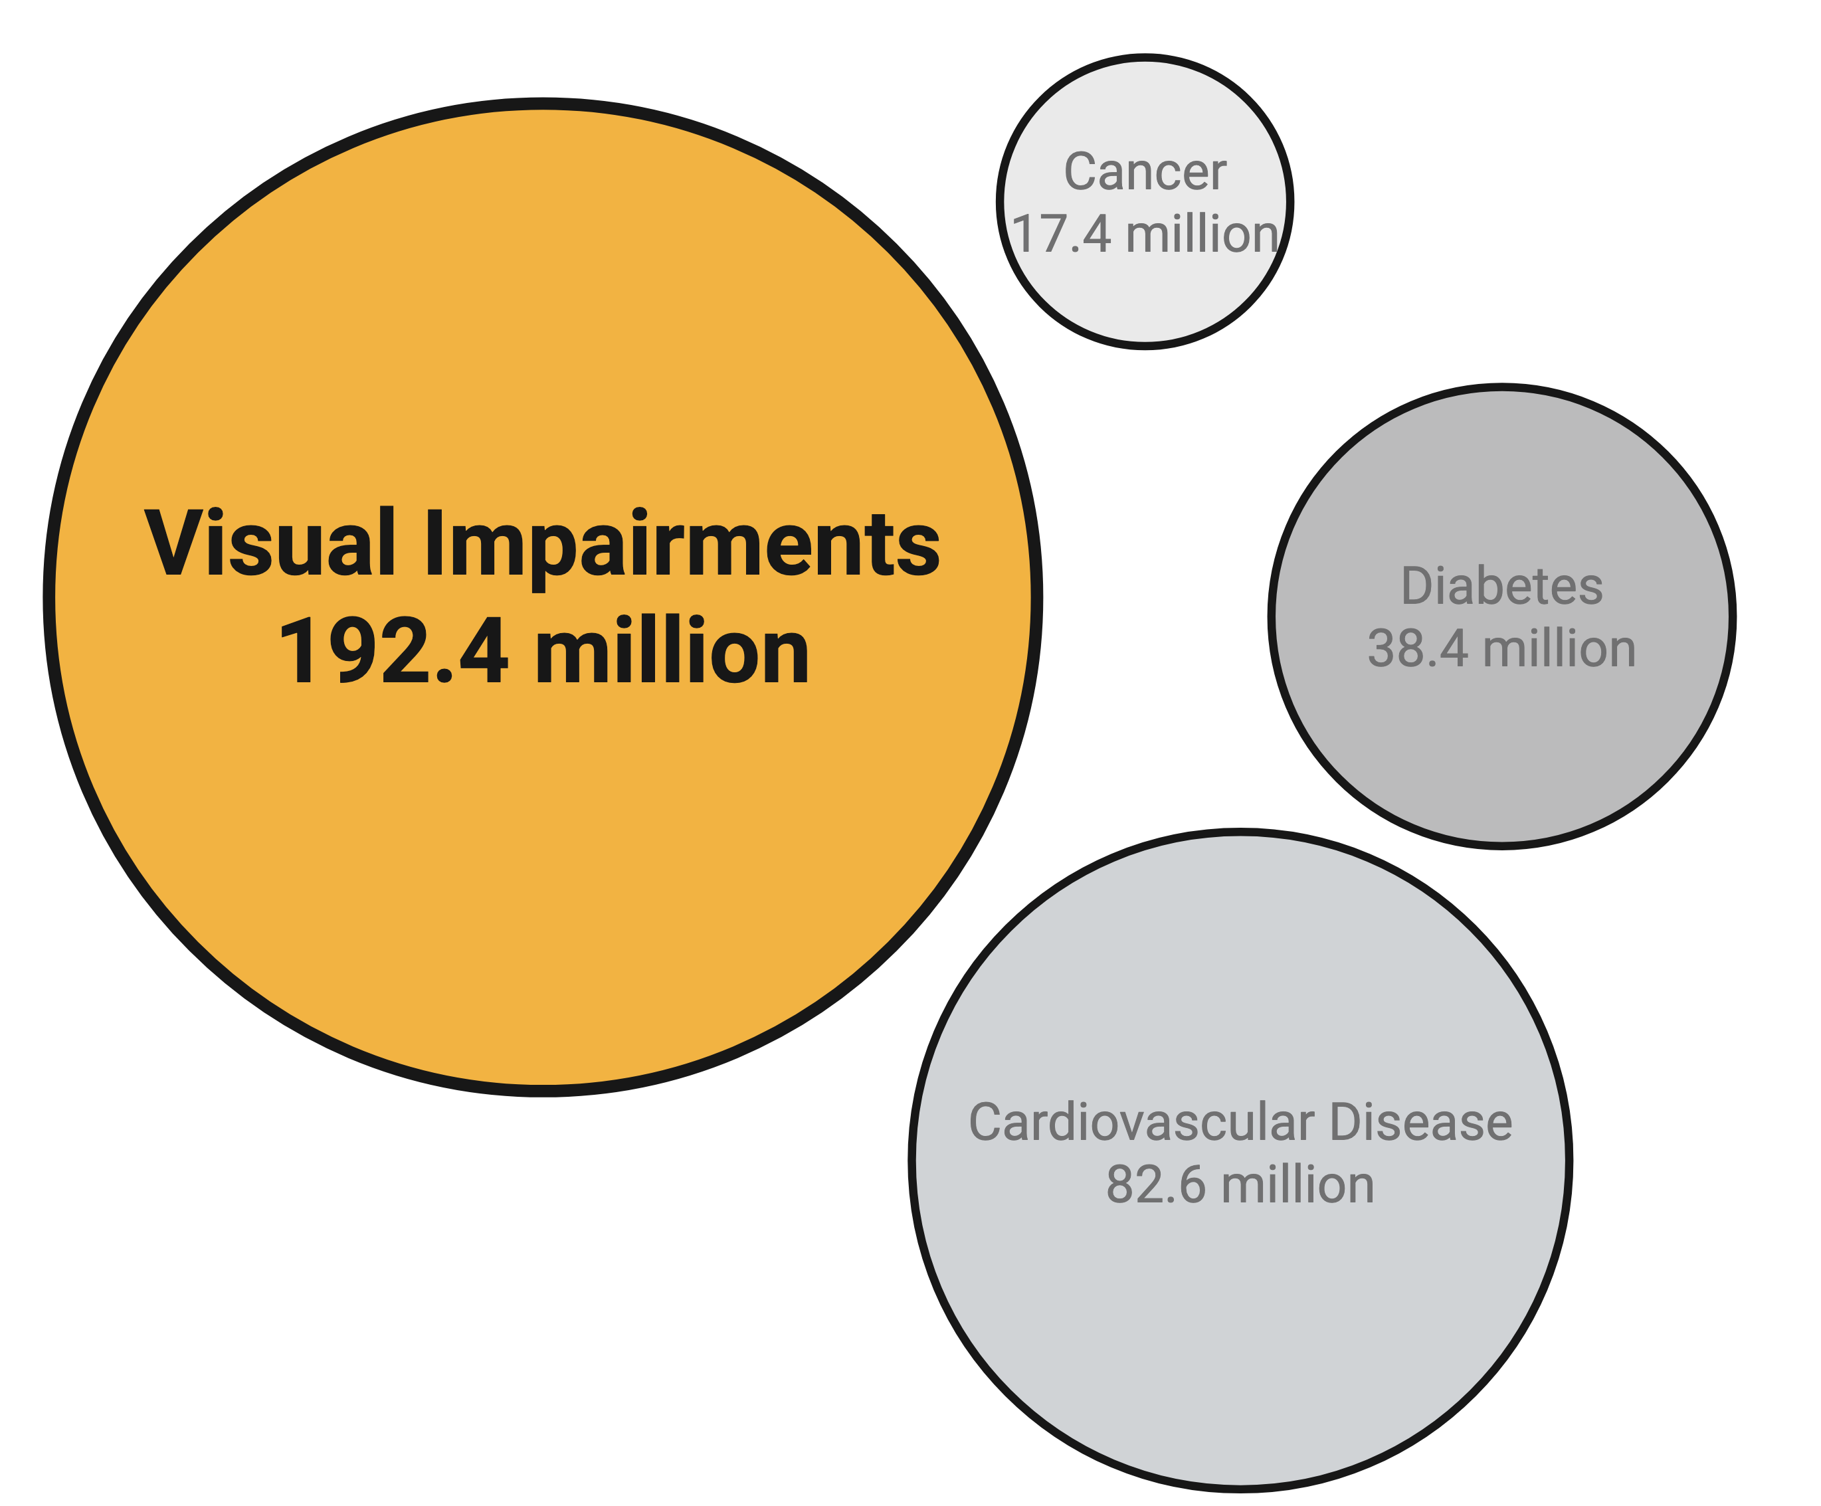
Visual impairments affect more Americans than many other health conditions. Dedicated eye research is essential for cutting edge treatments
Rein et al., JAMA Ophthalmol. 2022 doi: 10.1001/jamaophthalmol.2022.4401.
https://www.nvisioncenters.com/education/eye-disease-statistics/#cataracts
https://pubmed.ncbi.nlm.nih.gov/28705660/
https://www.cdc.gov/vision-health-data/prevalence-estimates/dr-prevalence.html
https://www.cdc.gov/vision-health-data/prevalence-estimates/prevalence-estimates-glaucoma.html
NASEM Myopia report; https://www.ncbi.nlm.nih.gov/sites/books/NBK607610/#:~:text=TABLE%203%2D4,8%2Dfold%20increase%20in%20prevalence.;
https://seer.cancer.gov/statfacts/html/all.html
https://www.cdc.gov/nchs/hus/topics/heart-disease-prevalence.htm; 5.5% in 2019; US population in 2019: 328.3 million
https://www.ncbi.nlm.nih.gov/books/NBK83160/
https://www.cdc.gov/diabetes/php/data-research/index.html
Save Sight, Save the NEI
Notes:
Rein DB, Wittenborn JS, Burke-Conte Z, Gulia R, Robalik T, Ehrlich JR, Lundeen EA, Flaxman AD. Prevalence of Age-Related Macular Degeneration in the US in 2019. JAMA Ophthalmol. 2022 Dec 1;140(12):1202-1208. doi: 10.1001/jamaophthalmol.2022.4401. PMID: 36326752; PMCID: PMC9634594.
https://www.nvisioncenters.com/education/eye-disease-statistics/#cataracts
https://pubmed.ncbi.nlm.nih.gov/28705660/
https://www.cdc.gov/vision-health-data/prevalence-estimates/dr-prevalence.html
https://www.cdc.gov/vision-health-data/prevalence-estimates/prevalence-estimates-glaucoma.html
NASEM Myopia report; https://www.ncbi.nlm.nih.gov/sites/books/NBK607610/#:~:text=TABLE%203%2D4,8%2Dfold%20increase%20in%20prevalence.; 292.8 million (2004), 41.6% myopia = 121.8 mil
https://seer.cancer.gov/statfacts/html/all.html
https://www.cdc.gov/nchs/hus/topics/heart-disease-prevalence.htm; 5.5% in 2019; US population in 2019: 328.3 million
https://www.ncbi.nlm.nih.gov/books/NBK83160/
https://www.cdc.gov/diabetes/php/data-research/index.html
----US population in 2024: 340.1 million

Slide 8
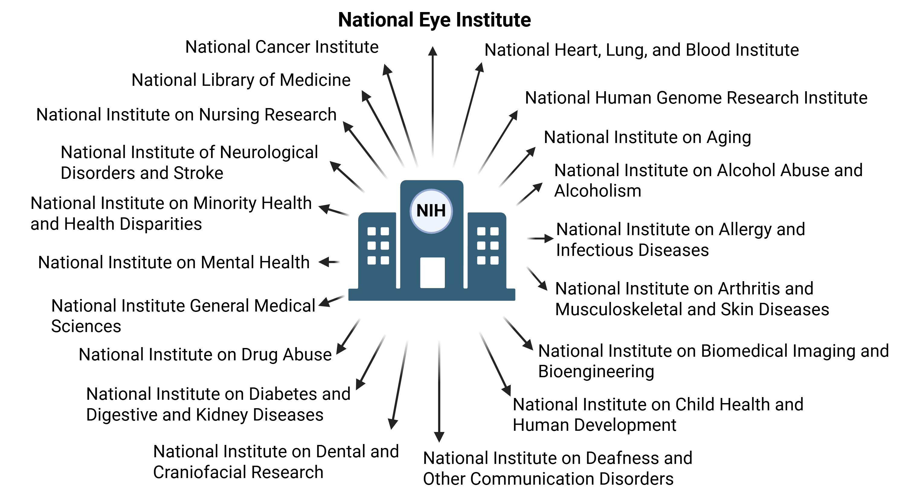
The National Eye Institute (NEI) is dedicated to preserving America’s eyesight

Slide 9
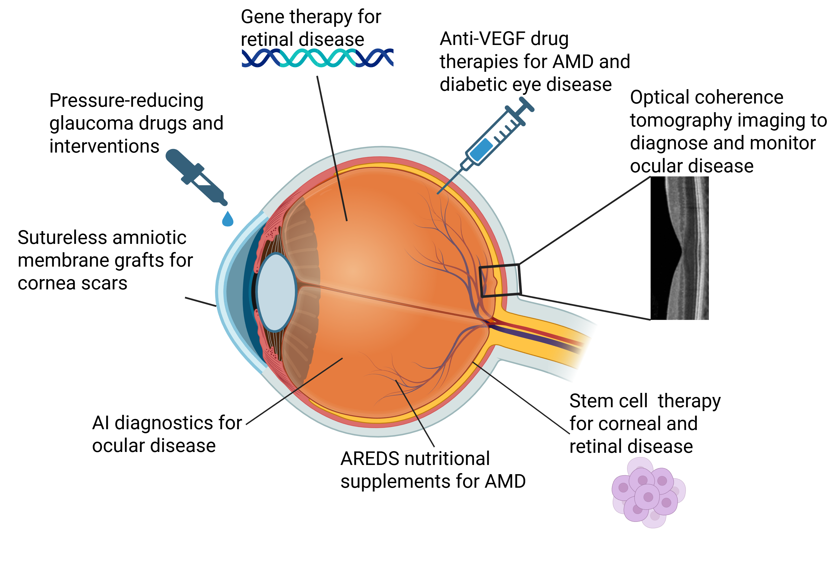
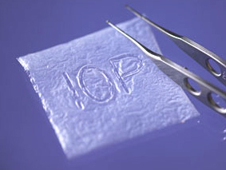


Partnership with the National Eye Institute (NEI) has helped
develop vision-saving treatments since 1968
Save Sight, Save the NEI
https://www.eyeresearch.org/
Notes:
https://eyewiki.org/File:Ambio2_1.jpg
https://www.linkedin.com/pulse/transforming-eye-care-ai-advancements-disease-andrew-livingston-ytogf
https://www.webrn-maculardegeneration.com/areds-2.html

Slide 10
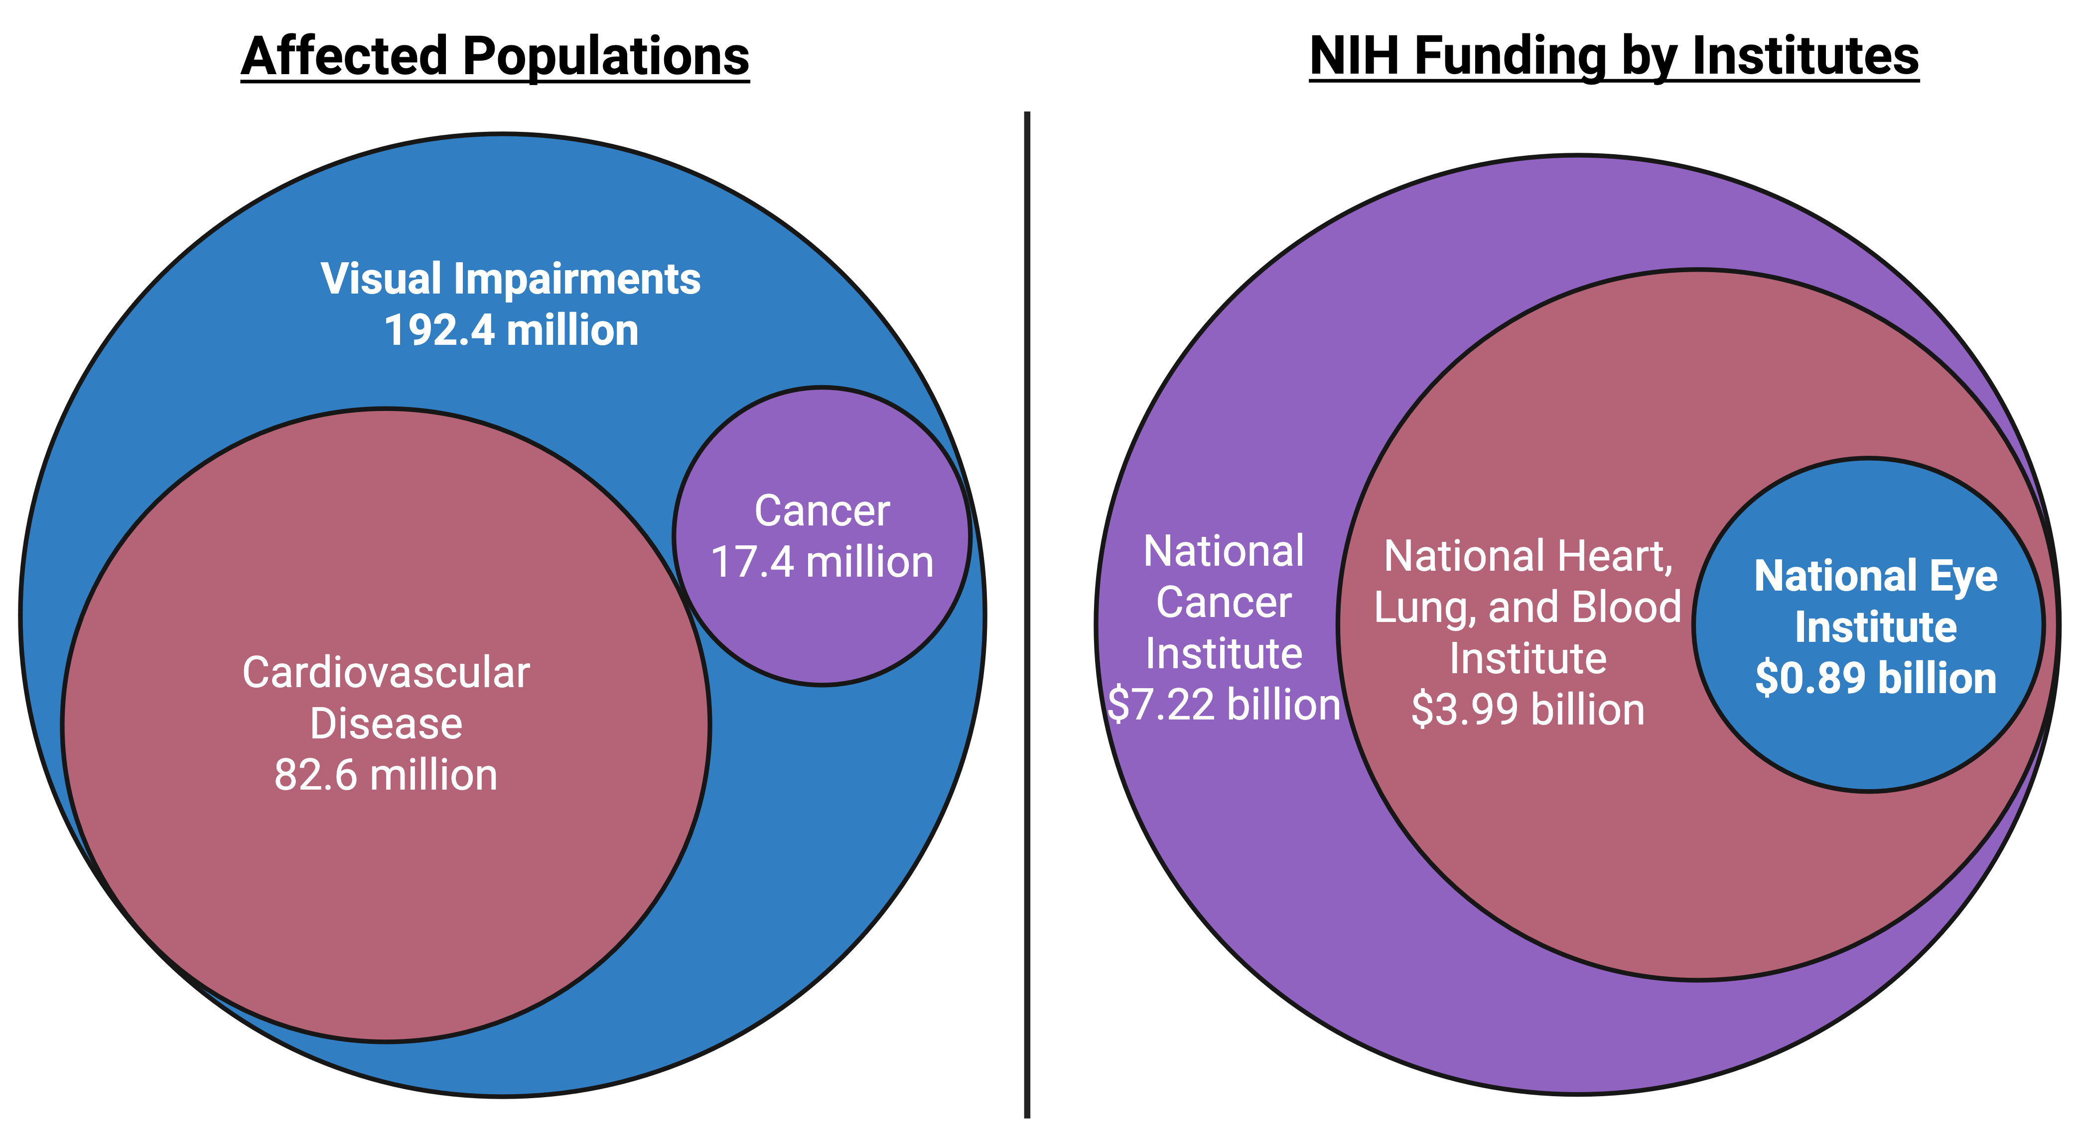
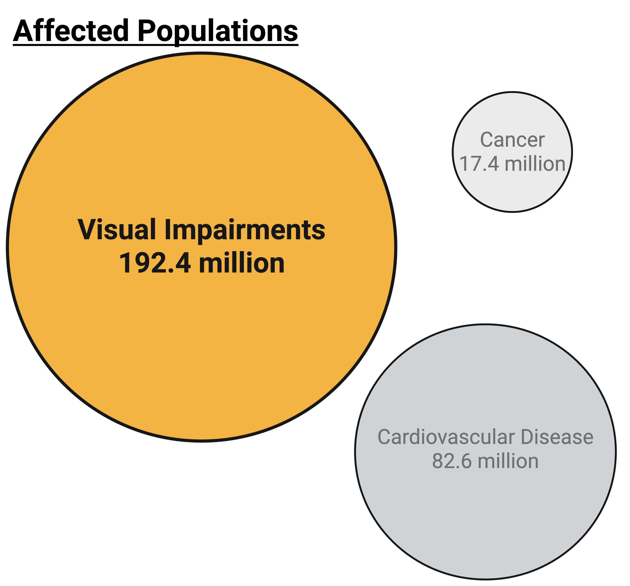
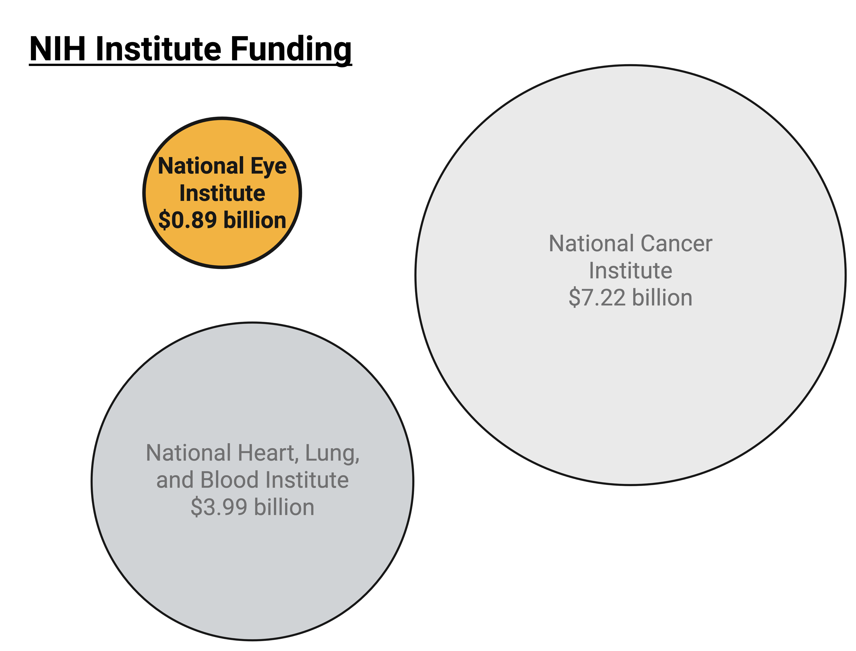
Eye research is underfunded compared to the number of Americans affected with visual impairments
Rein et al., JAMA Ophthalmol. 2022 doi: 10.1001/jamaophthalmol.2022.4401.
https://www.nvisioncenters.com/education/eye-disease-statistics/#cataracts
https://pubmed.ncbi.nlm.nih.gov/28705660/
https://www.cdc.gov/vision-health-data/prevalence-estimates/dr-prevalence.html
https://www.cdc.gov/vision-health-data/prevalence-estimates/prevalence-estimates-glaucoma.html
NASEM Myopia report; https://www.ncbi.nlm.nih.gov/sites/books/NBK607610/#:~:text=TABLE%203%2D4,8%2Dfold%20increase%20in%20prevalence.;
https://seer.cancer.gov/statfacts/html/all.html
https://www.cdc.gov/nchs/hus/topics/heart-disease-prevalence.htm; 5.5% in 2019; US population in 2019: 328.3 million
https://www.ncbi.nlm.nih.gov/books/NBK83160/
https://www.congress.gov/crs_external_products/R/HTML/R43341.web.html#_Ref168907750
Save Sight, Save the NEI
Notes:
Rein DB, Wittenborn JS, Burke-Conte Z, Gulia R, Robalik T, Ehrlich JR, Lundeen EA, Flaxman AD. Prevalence of Age-Related Macular Degeneration in the US in 2019. JAMA Ophthalmol. 2022 Dec 1;140(12):1202-1208. doi: 10.1001/jamaophthalmol.2022.4401. PMID: 36326752; PMCID: PMC9634594.
https://www.nvisioncenters.com/education/eye-disease-statistics/#cataracts
https://pubmed.ncbi.nlm.nih.gov/28705660/
https://www.cdc.gov/vision-health-data/prevalence-estimates/dr-prevalence.html
https://www.cdc.gov/vision-health-data/prevalence-estimates/prevalence-estimates-glaucoma.html
NASEM Myopia report; https://www.ncbi.nlm.nih.gov/sites/books/NBK607610/#:~:text=TABLE%203%2D4,8%2Dfold%20increase%20in%20prevalence.; 292.8 million (2004), 41.6% myopia = 121.8 mil
https://seer.cancer.gov/statfacts/html/all.html
https://seer.cancer.gov/statfacts/html/breast.html
https://www.cdc.gov/nchs/hus/topics/heart-disease-prevalence.htm; 5.5% in 2019; US population in 2019: 328.3 million
https://www.alz.org/alzheimers-dementia/facts-figures#quickFacts
https://www.ncbi.nlm.nih.gov/books/NBK83160/
https://www.cdc.gov/diabetes/php/data-research/index.html
https://www.congress.gov/crs_external_products/R/HTML/R43341.web.html#_Ref168907750

Slide 11
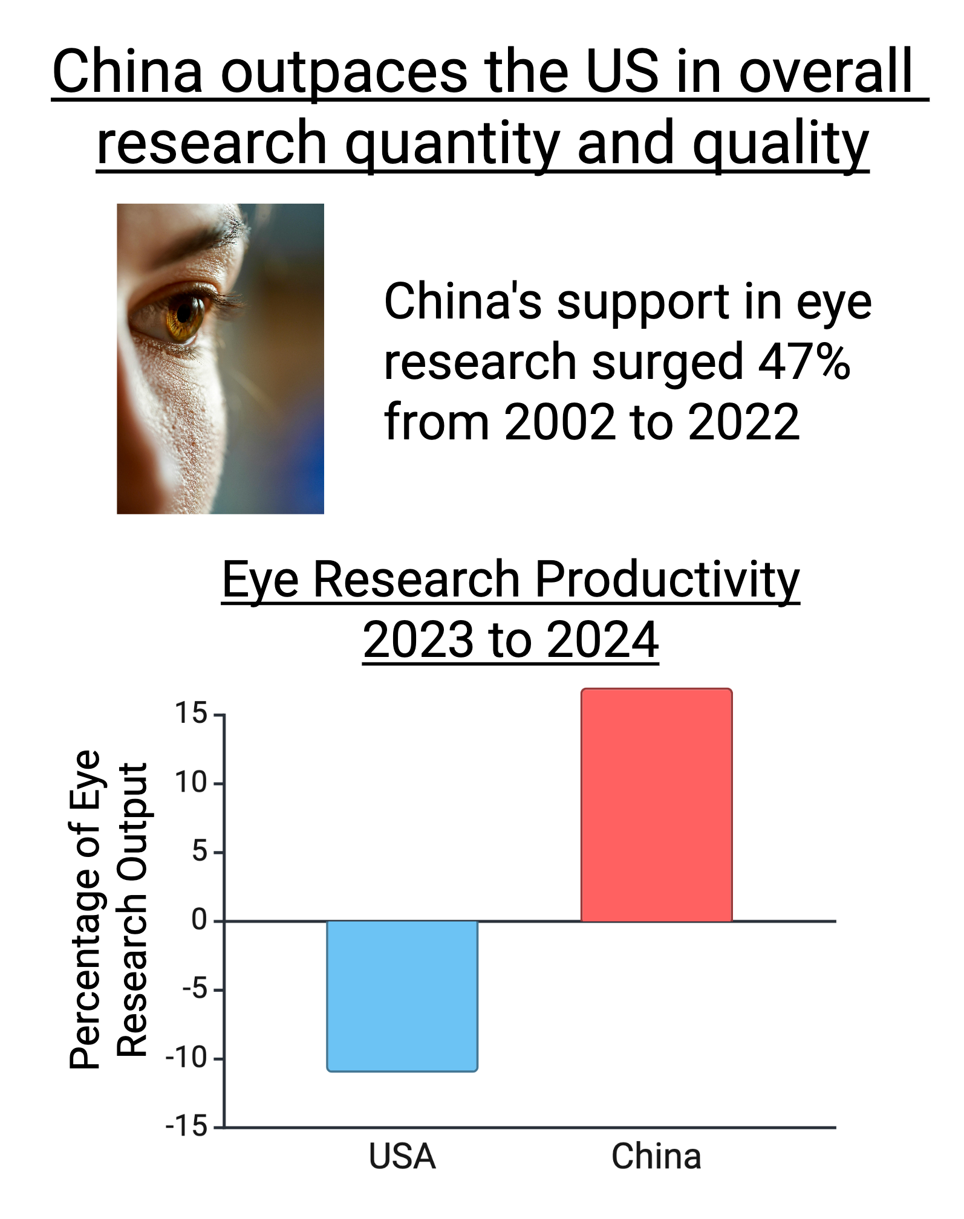
China outpaces the US in overall research quantity and quality

Slide 12
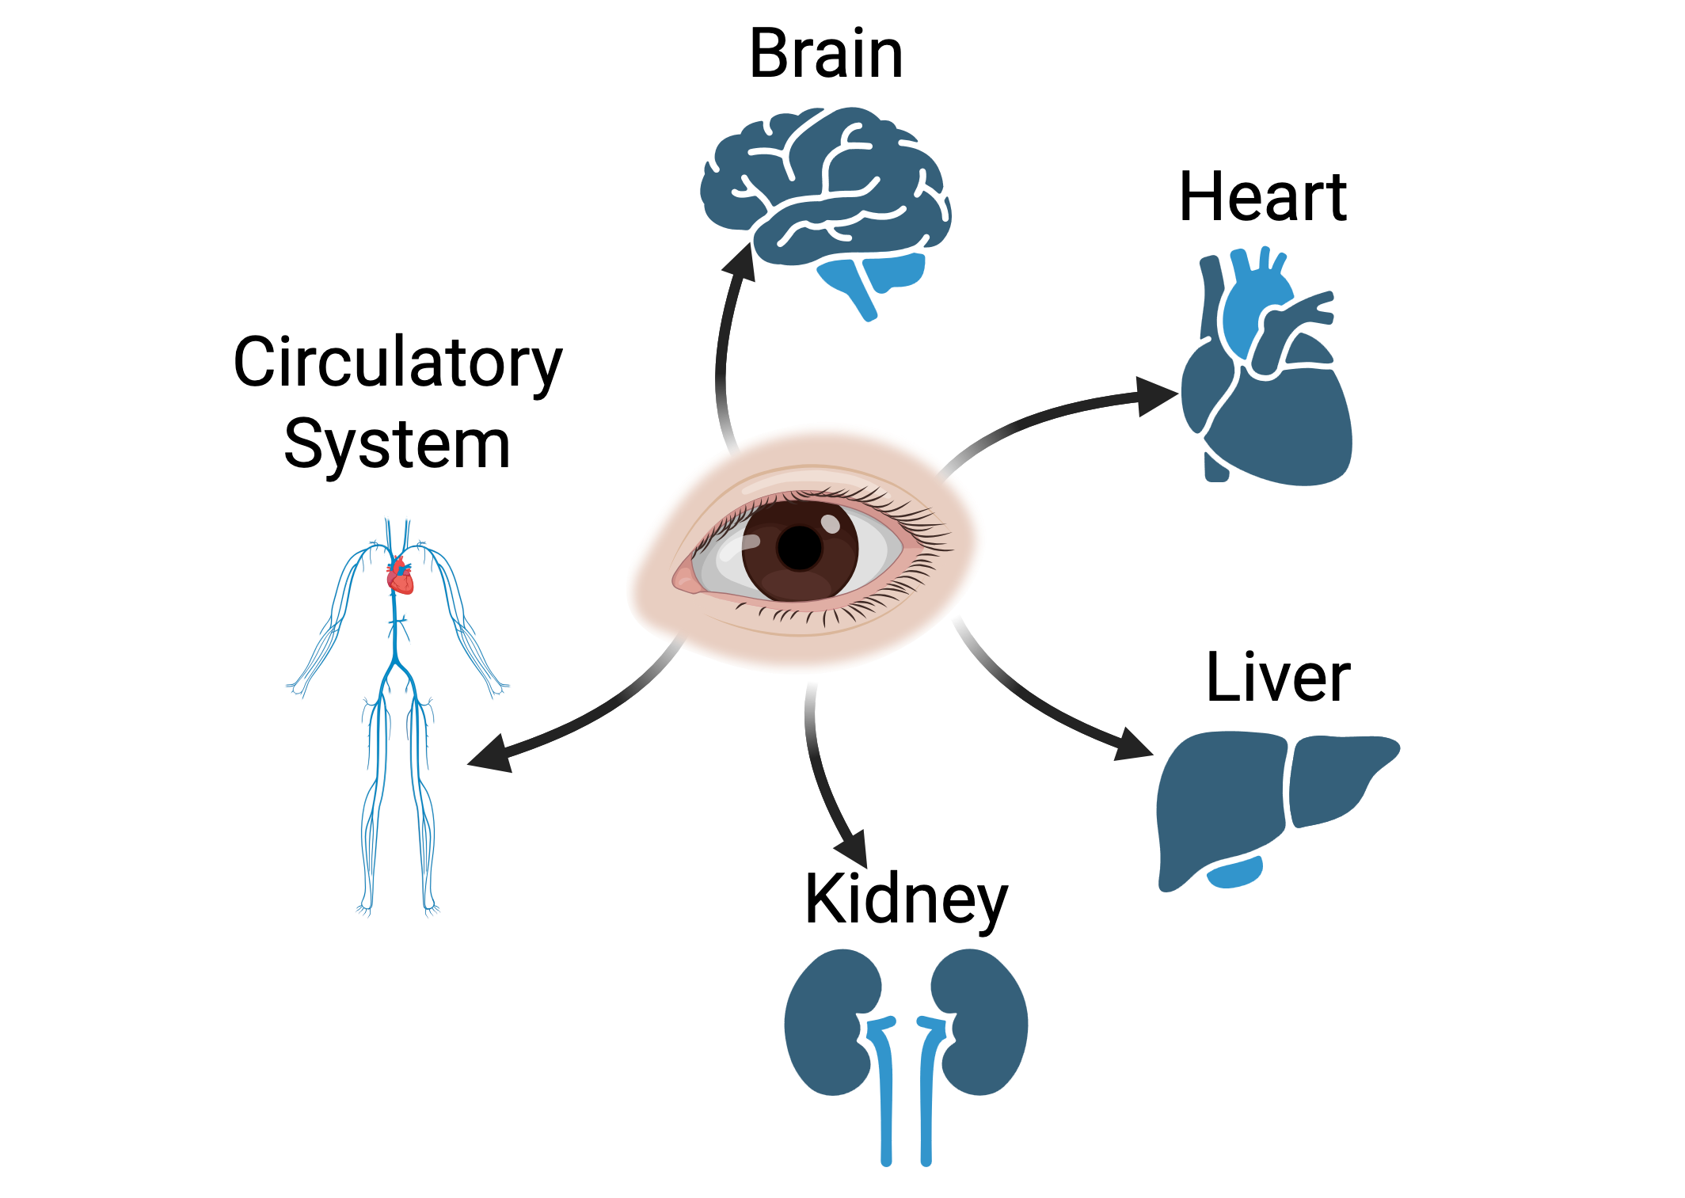
Prediction and monitoring of body health through the eye is made possible by funding from NEI

Slide 13
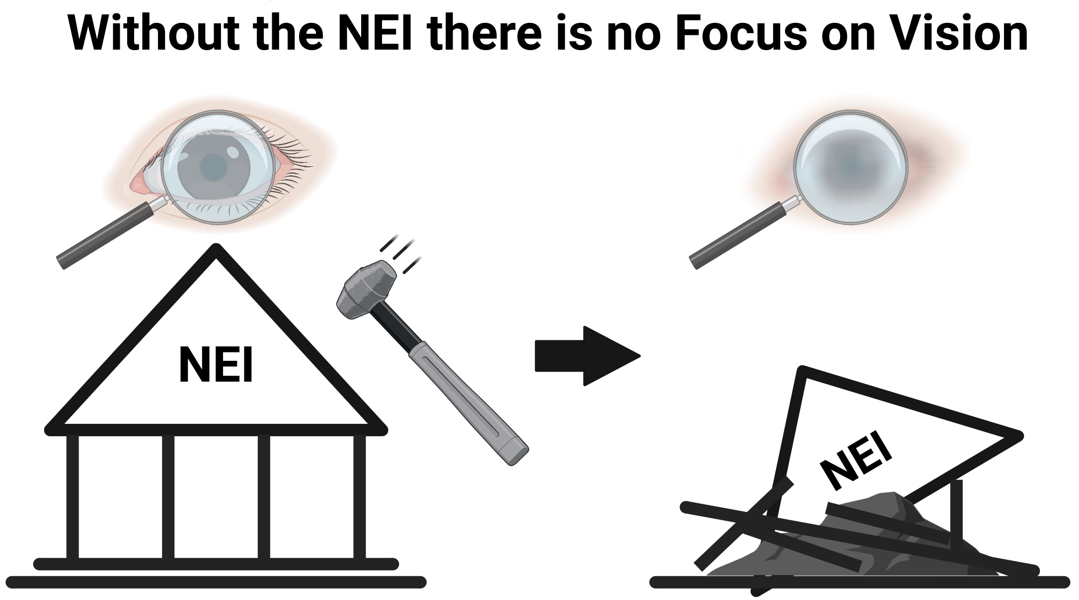
Save Sight, Save the NEI
Notes:
Data from AIMBE and UnitedforMedicalResearch.org

Slide 14
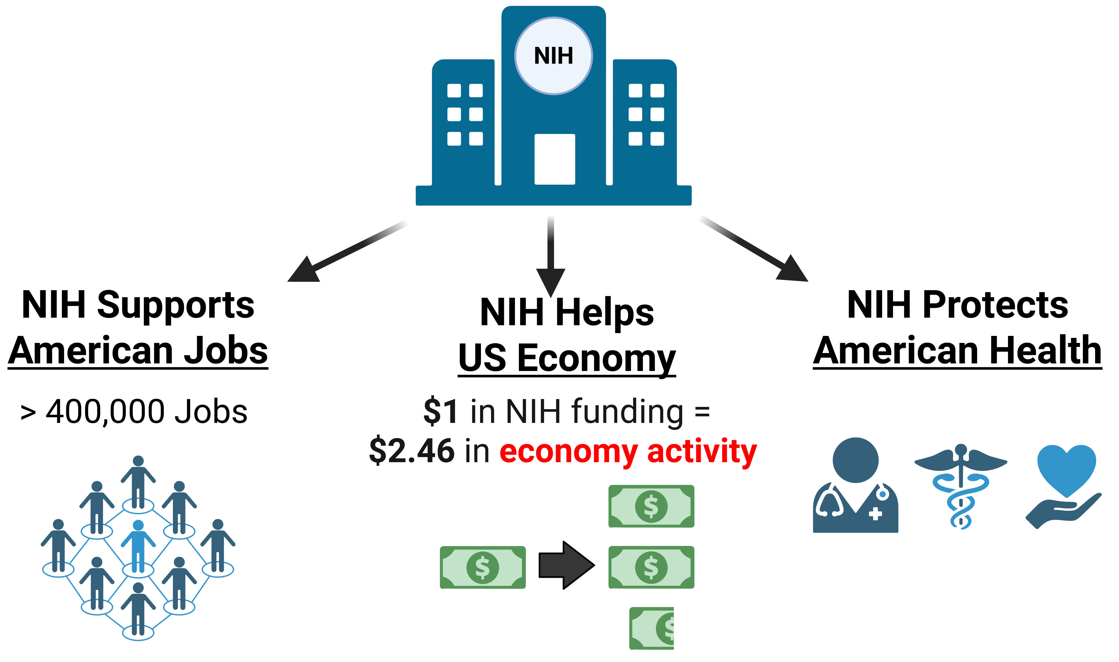
The NIH Supports, Helps, and Protects Americans
AIMBE.org
UnitedforMedicalResearch.org
Notes:
Data from AIMBE and UnitedforMedicalResearch.org

Slide 15
There is an urgent need to increase awareness of vision disorders and importance of vision research to prevent blindness
We need a grassroots effort to Promote Eye Research and Save the NEI
This information is meant to be shared, edited, and expanded.
To Prevent Blindness and Keep “eye” in NIH, contact Congress, go to
www.eyeresearch.org/contact-congress
For more information, contact www.eyeresearch.org

Slide 16
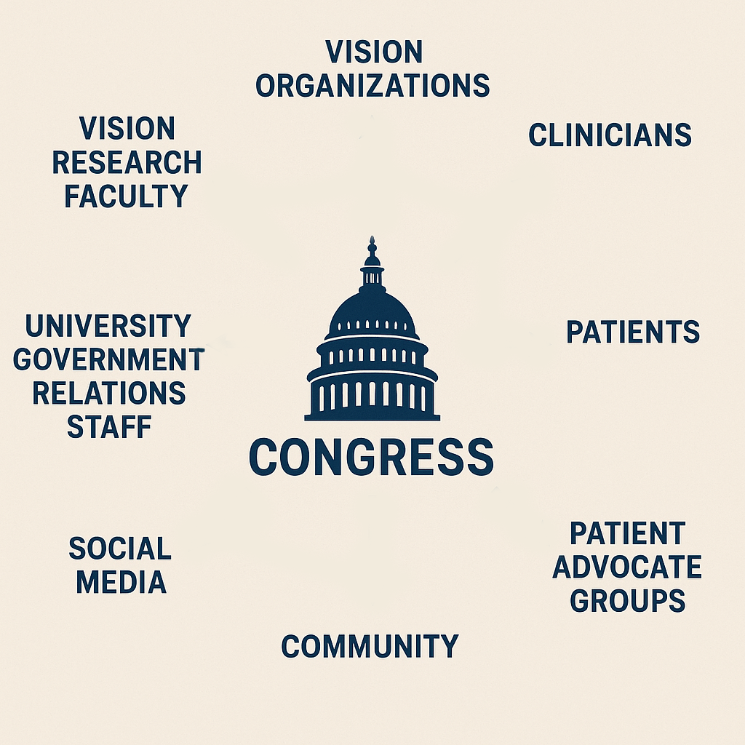
Pathways to disseminate this information with the goal to promote Eye Research and save NEI
Ideas to disseminate this information
Share with clinical faculty seeing patients
Video displays in patient waiting areas
Share with community members
Share with vision patient advocacy groups
Share with institutional governmental relations team that meet with Congressional staffers
Share on social media
Arrange congressional visits with your state representatives

Slide 17
Data slides The data for the graphics can be found here

Slide 18
Biomedical research supports advanced healthcare and economic activity in the US
Sustained support for biomedical research has made the U.S. a world leader in innovative healthcare that saves lives and improves health
National Institutes of Health (NIH) is the major funding agency for US biomedical research and supports research in every state
NIH-funded research produced $94.58 billion in new economic activity and over 400,000 jobs in FY24
For every $1 in NIH research, the US has $2.46 increase in new economic activity
Notes:
Data from AIMBE and UnitedforMedicalResearch.org

Slide 19
Eliminating the National Eye Institute will negatively impact visual health and treatment options for eye disease
Vision loss is the top health concern for Americans
Vision disorders and disease affect 65.5 million Americans, 19% of the population
The prevalence of visual disorders and disease is greater than the prevalence of cancer, heart disease, and Alzheimer’s combined (46 million)
Decreased vision negatively impacts quality of life
Decreased vision impacts earning potential ($8 billion annually)
Visual health and treatments for visual disease matter
Save the National Eye Institute to support Eye Research and Eye Care
Notes:
-Scott AW, Bressler NM, Ffolkes S, Wittenborn JS, Jorkasky J. Public Attitudes About Eye and Vision Health. JAMA Ophthalmol. 2016 Oct 1;134(10):1111-1118. doi: 10.1001/jamaophthalmol.2016.2627. PMID: 27490785.
-Rein DB, Zhang P, Wirth KE, et al. The Economic Burden of Major Adult Visual Disorders in the United States. Arch Ophthalmol 2006;124(12):1754–1760

Slide 20
Visual disease and disorders affects 65.5 million Americans – more than cancer, heart disease, and Alzheimer’s disease (42.4 million)
Visual disease and disorders include:
AMD, 19.83 million age 40 and older¹
Cataracts, 20.5 million²
Dry eye disease, 16.4 million³
Diabetic Retinopathy, 9.6 million⁴
Glaucoma, 4.22 million⁵
Myopia, 121.8 million⁶
Compare this with other major health diseases:
Cancer, 17.4 million⁷
Breast cancer, 3.9 million⁸
Heart disease, 18.06 million⁹
Cardiovascular disease, 82.6 million¹¹
Diabetes, 38.4 million people¹²
Alzheimer’s disease, 6.9 million¹⁰
Notes:
Rein DB, Wittenborn JS, Burke-Conte Z, Gulia R, Robalik T, Ehrlich JR, Lundeen EA, Flaxman AD. Prevalence of Age-Related Macular Degeneration in the US in 2019. JAMA Ophthalmol. 2022 Dec 1;140(12):1202-1208. doi: 10.1001/jamaophthalmol.2022.4401. PMID: 36326752; PMCID: PMC9634594.
https://www.nvisioncenters.com/education/eye-disease-statistics/#cataracts
https://pubmed.ncbi.nlm.nih.gov/28705660/
https://www.cdc.gov/vision-health-data/prevalence-estimates/dr-prevalence.html
https://www.cdc.gov/vision-health-data/prevalence-estimates/prevalence-estimates-glaucoma.html
NASEM Myopia report; https://www.ncbi.nlm.nih.gov/sites/books/NBK607610/#:~:text=TABLE%203%2D4,8%2Dfold%20increase%20in%20prevalence.; 292.8 million (2004), 41.6% myopia = 121.8 mil
https://seer.cancer.gov/statfacts/html/all.html
https://seer.cancer.gov/statfacts/html/breast.html
https://www.cdc.gov/nchs/hus/topics/heart-disease-prevalence.htm; 5.5% in 2019; US population in 2019: 328.3 million
https://www.alz.org/alzheimers-dementia/facts-figures#quickFacts
https://www.ncbi.nlm.nih.gov/books/NBK83160/
https://www.cdc.gov/diabetes/php/data-research/index.html
----US population in 2024: 340.1 million

Slide 21
NEI research directly supports clinical eye care
Optical coherence tomography
Gene therapy
Stem cell therapy
Artificial Intelligence
Anti-VEGF Drug Therapies for AMD and diabetic eye disease
AREDS Nutritional supplements for AMD
Pressure-reducing glaucoma drugs
Sutureless amniotic membrane grafts for cornea scars
Notes:
https://www.eyeresearch.org/

Slide 22
Economic impact of visual disease and disorders
The direct medical costs for major adult visual disorders are estimated to be $35.4 billion annually, including refractive errors, cataracts, glaucoma, AMD, and diabetic retinopathy.
Direct medical costs: $16.2 billion
Other direct costs: $11.1 billion
Productivity losses: $8 billion
Annually, the federal government and state Medicaid agencies pay at least $13.7 billion of these costs.
Notes:
Rein DB, Zhang P, Wirth KE, et al. The Economic Burden of Major Adult Visual Disorders in the United States. Arch Ophthalmol 2006;124(12):1754–1760

Slide 23
Major eye research advances that impact eye health
National Eye Institute created by Congress in 1968
Clinical trials on Diabetic Retinopathy that established current treatments (1971)
Glaucoma Laser Trial (1990)
RPE65 is cloned, advancing understanding of certain genetic mutations that cause blindness in children (1993)
AREDS study to lower risk of AMD (2001)
Cornea Donor Study that increased pool of donors for corneal transplants (2008)

Slide 24
Economic impact of visual disease and disorders
The direct medical costs for major adult visual disorders, including refractive errors, cataracts, glaucoma, AMD, and diabetic retinopathy, are estimated to be $35.4 billion annually.
Direct medical costs: $16.2 billion
Other direct costs: $11.1 billion
Productivity losses: $8 billion
Annually, the federal government and state Medicaid agencies pay at least $13.7 billion of these costs.
Uncorrected refractive errors, primarily myopia, pose a significant economic burden in the US, with estimates suggesting annual productivity losses of around $202 billion
The direct medical costs for refractive error alone are estimated to be around $5.5 billion.
Annual global productivity losses associated with vision impairment from uncorrected myopia in adults and presbyopia are estimated to be US$ 244 billion and US$ 25.4 billion, respectively.
Notes:
Rein DB, Zhang P, Wirth KE, et al. The Economic Burden of Major Adult Visual Disorders in the United States. Arch Ophthalmol 2006;124(12):1754–1760

